Slide 1
Machine Learning
Day 1 - Session 2

Slide 2
outlines
Linear Regression
How to assess Regression Models

Slide 3
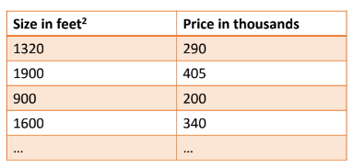
Linear Regression
Let’s assume the following dataset
Data set
n cases i= 1,2,.......n
1 target variable (price)
t_{i} , i =1,2,.......n
t₁ =290, t₂ =405, t₃ =200, ....
1 input variable (size)
x_{i} , i =1,2,.......n
x₁ =1320, x₂ =1900, x₃ =900, ....

Slide 4





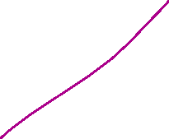







Linear reg
Y(pred) = ax + b = theta0 + theta_1 x
Y(actual)
Y_act = 10
Y_pred = 8
E = diff = 10-8 = 2
E = 200 – 100 = 100
Act = [1 2 3 4 5 ]
Pred = [3 3 3 3 3]
Diff = e = 1/5(-2 + -1 + 0 + 1 + 2) cost function / loss function
MAE = 6/5
MSE = 4 + 1 + 4 +1 = 10/5

Slide 5










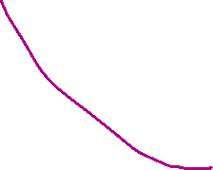




Y_pred = b +ax ?? Not good
Gradient descent
Gradient =
MSE = 1/m((b + a x) – y_act)^2
Grad0 = Diff mse/b=2/m ((b + a x) – y_act)(1)
grad 1 = Diff mse/a=2/m ((b + a x) – y_act)(x)
b(neew) = b – eta * grad0
a(neew) = a – eta * grad1

Slide 6










Linear regression ?? Fit data assume data is linear
Pred = mx + b
Pred = theta0 + theta1 x
Init theta0 , theta1 random
Pred not true
Pred = [1,2,3,4]
Actual =[4,3,2,1]
E = (1-4)+(2-3)+(3-2)+(4-1) = 0
L1 = \\\

Slide 7
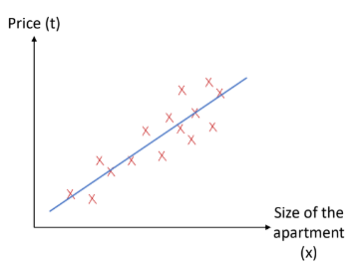
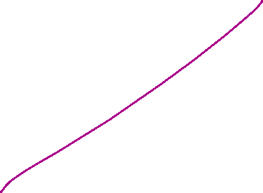
Linear Regression
Assumes a linear relationship
between the mean of the target/
output variable (the factor you are
trying to predict (also known as the
dependent variable ) and the input
variables (features that are expected
to affect the target variable (also
known as “predictor/ explanatory”
variables)
t_{i} = θ₁ ∗ x_{i} + θ₀ + ε_{i}

Slide 8
Y = theta0 + theta1 * x + e
E = error
T , y , out , dependent
Theta 0 , theta 1
Predict = 50
Actual data = 48
E = 50-48 = 2

Slide 9
Assume data linear
Line equation that fit data
Y = theta0 +theta1*x
Prediction compare with actual
Error ➔ mean square error
Best theta0,theta 1 that min(MSE)
Min(MSE)

Slide 10



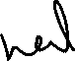

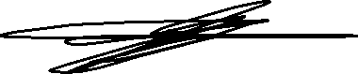
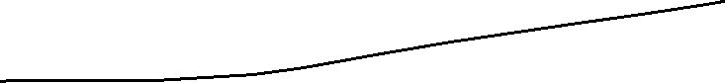

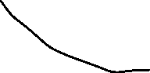
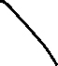
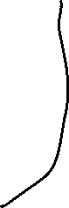
Pred =
Loss function ➔1 convex , 2 differentiable
Pred = 2,5,7,9
Actual = 5,2,7,9
E = pred – actual
E = 2-5) + 5-2) + 0 + 0 = 0
MSE = 0.25(9+9+0+0) = 4.5

Slide 11


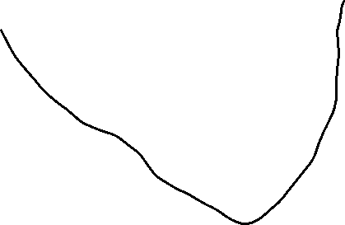
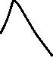
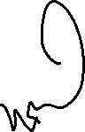
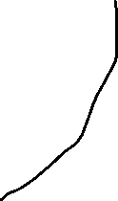





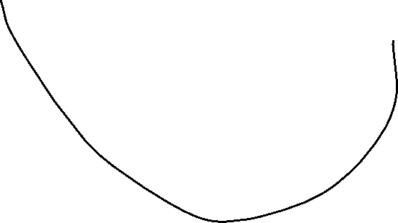

Theta = theta – eta*grad

Slide 12
MSE = (pred – actual )^2
MSE = 1/2m[(theta0 + theta1x) – actual ]^2
Theta0 = theta0 – eta*d/d_theta0(MSE)تفاضل دالة الايرور بالنسبة لل سيتا صفر
= theta0 – eta* 2/2m[(theat0+theta1x) – y]*(1+0 - 0)
Theta0 = theata0 – eta *1/m[y_pred – y_actual]
Theta1= theata1 – eta *1/m[y_pred – y_actual]*x

Slide 13
Assume data linear
pred = theta0 + thta1x , y actual

Slide 14
What shall the model learn in that case?
We need to learn θ₀ and θ₁ (model parameters)
• If I can estimate θ₀ and θ₁ correctly, I have an estimation of the output
given the input attributes with some error (ε_{i}).
• Prediction error (residual) is defined as ε_{i} = t_{i} − y_{i}
t_{i} : observed output value for dataset record i (true price value in the previous example).
y_{i} : our estimate of the target variable for dataset record i
(y_{i} = θ₁∗ x_{i} + θ₀).
• How can we estimate θ₀ and θ₁?

Slide 15
Least Squares
The most popular estimation method.
Least Squares Criterion: “minimize the sum of the squared prediction errors.”
Residual Sum of Squares RSS = e₁² + e₂² + ⋯ . + e_{n}²
find the values θ₀ and θ₁ that make the sum of the squared prediction errors the smallest it can be.
How? Using the Ordinary least squares (OLS) method

Slide 16

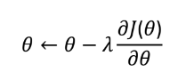
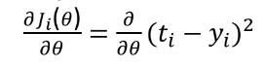
Gradient Descent
One of the generic algorithms used to solve optimization problems
1. Initialize θ randomly.
2. repeatedly update θ based on the gradient
For a single training case i:

Slide 17
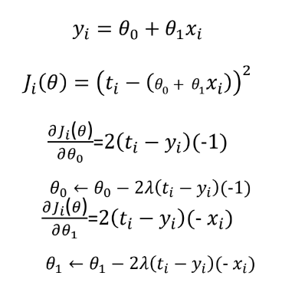
Gradient Descent

Slide 18
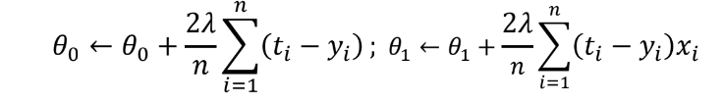
Gradient Descent Types
For all points in the data set
Batch update
Sum or average updates across every example , update for all samples.
Mini-Batch update
Sum or average updates across n examples, update for n samples.
Stochastic/online updates: update the parameters for each training
case in turn, according to its own gradients.

Slide 19
Epoch ?? لفة دورة كامله
Data size = m
Full batch ➔ 1 step
Mini batch ➔ m/b where b = batch size
Stochastic➔m step(iteration)
1-1

Slide 20
Epoch? Data size = m
Stochastic:
Example by example 1 epoch = m step (iteration)
Mini batch : batch size = b ➔m/b step(iteration)
Full Batch :
1 epoch ➔ 1 step (iteration)

Slide 21
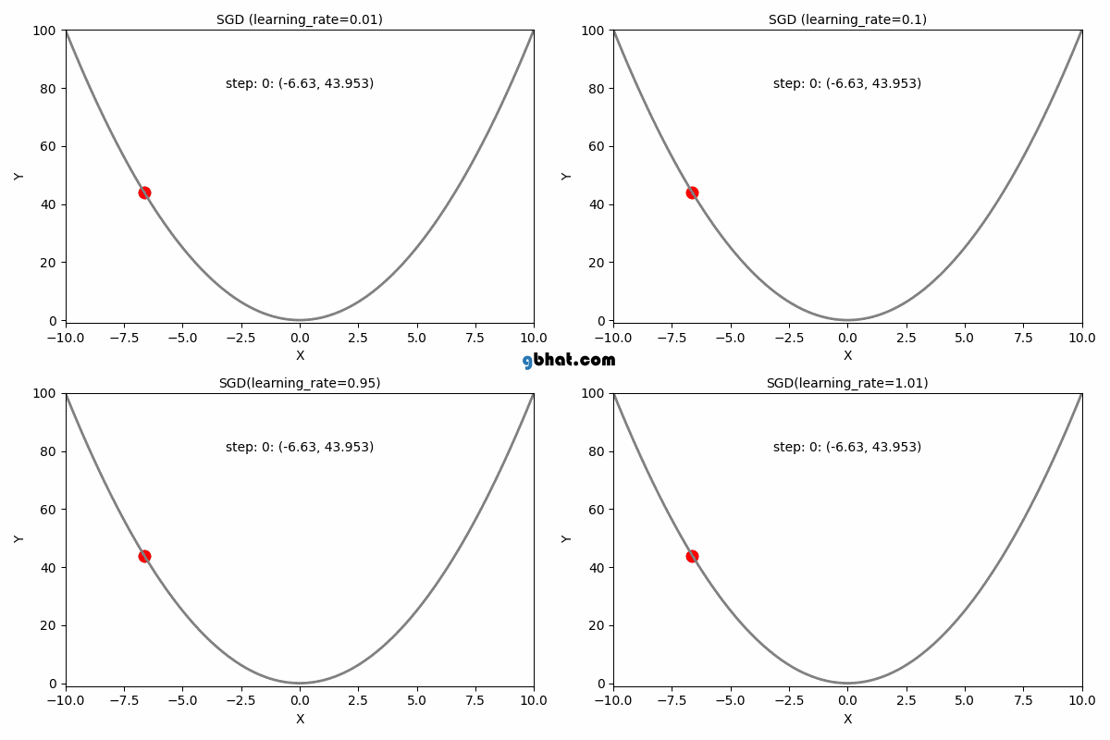
Effect of Learning rate

Slide 22
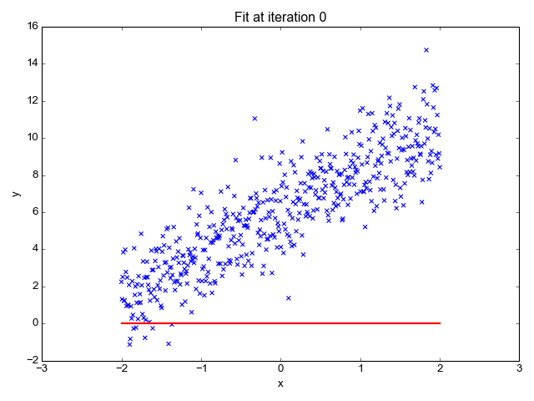
Linear Regression

Slide 23
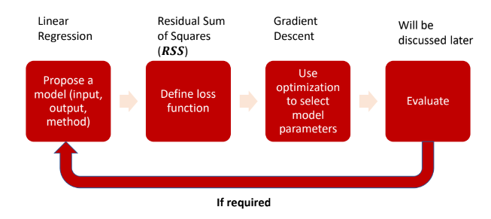
Steps of Linear Regression

Slide 24
What if the data wasn’t linear to begin with?

Slide 25
Random sampling
Data 1000 ➔ a 500 , b 300 , c200
Test data ➔ 100
Random ➔40 a , 40 b , 20 c
Stratified ➔50 a , 30 b , 20 c

Slide 26
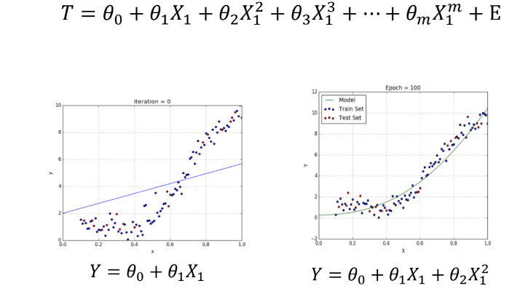
Polynomial Regression
As we can see simple linear regression doesn’t fit the data well.
Remember why?

Slide 27
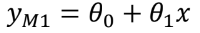
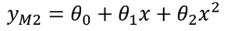
Capacity
A linear regression model (M1) with two parameters (A polynomial of degree one)
The model can fit several functions. For example y = 4; y = 2x; y = 3 +1.5x; y = 0.5 + 0.25x
By adding one more parameter and use x² (A polynomial of degree 2)
The model (M2) can fit several more functions that cannot be represented by the first mode. For example y = 2x² ; y = 2 + 1.5x²; y = 0.5x +0.2x²
It can also fit all functions of M1.
We say that M2 has more capacity than M1

Slide 28
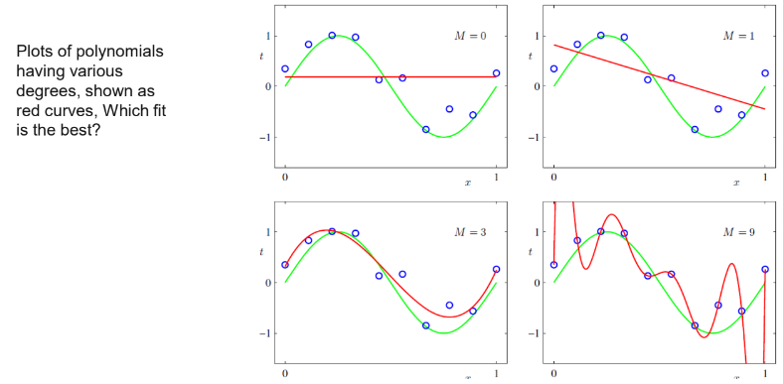
Polynomial Regression
Using Linear regression assumes the data is linear (of the first degree)
But using the polynomial regression all we need is to figure out the degree of the data to be able to fit a model.

Slide 29
Does having more capacity means better performance?
We can always use high capacity model and hope it fits the right model
How can we evaluate the performance in that case?

Slide 30
Train Test Split
We split the data into two segments:
Training set, used to learn the model parameters. The error calculated using this set is called the training error.
Test set, used to assess the generalization of the model (Model’s ability to perform well on unseen data). Why is this important?

Slide 31
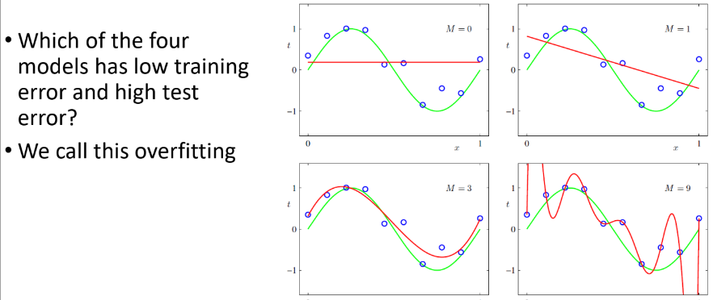
Overfitting and Underfitting

Slide 32
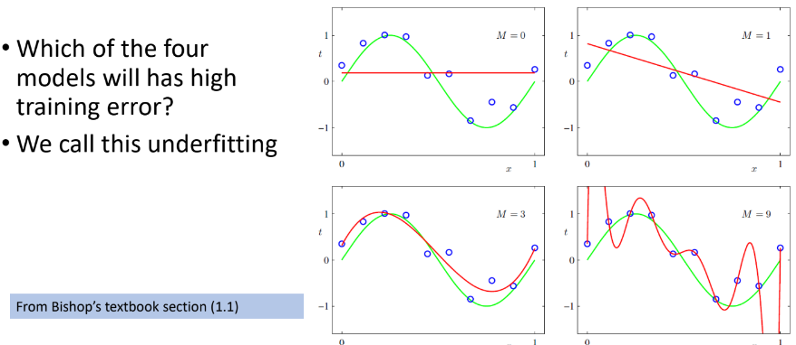
Overfitting and Underfitting

Slide 33
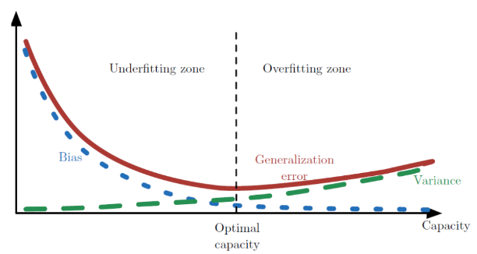
Bias-Variance trade off var: Model with high variance pays a lot of attention to training data and does not generalize on the data which it hasn’t seen before(overfitting) bias: Is the diff between avg prediction our model ad the correct value which we trying to predict(underfitting)
Increasing capacity can lead to more Generalization Error

Slide 34

How can we prevent overfitting
Best way is to train the model using more data
Sometimes this is difficult. We can also
Reduce model complexity.
Use regularization techniques:
Any modification we make to a learning algorithm that is intended to reduce its generalization/test error, but not its training error.

Slide 35
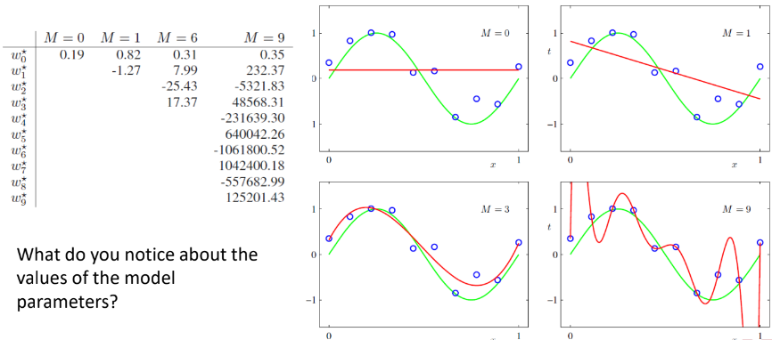
Let’s have a closer look at the previous example

Slide 36
Overfitting (train performance higher than test )(can't generalize)
Y = w0 + w1x +w2x^2 +…. + wn x^n
Min (MSE = 1/m(pred – act )^2 + sum(|wi|) ) lasso
Min (MSE = 1/m(pred – act )^2 + sum ((wi)^2) ) ridge
Min (MSE = 1/m(pred – act )^2 + r sum ((wi)^2) ) +(1-r) sum(|wi|) )

Slide 37
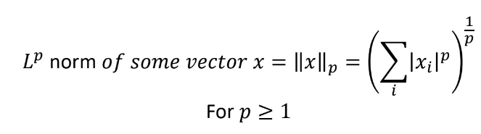
Regularization
A possible way to avoid overfitting is to add extra terms in the objective function that can be thought as corresponding to a soft constraint on the parameter values.
A measure the size of a vector (maps a vector to a non-negative value representing its size).
L^{p} norm is given by

Slide 38
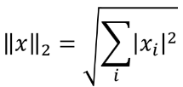
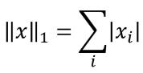
L¹ norm and L² norm
For p=2 (L² norm )
L² norm is simply the Euclidean distance from the origin to the point identified by x
The squared L² ||x||₂² norm is typically more convenient to work with
mathematically and computationally than the L² norm itself.
For p=1 (L¹ norm )

Slide 39
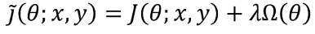
Using the norm to constrain parameter values
Basic idea: add a parameter norm penalty Ω(θ) to the objective
function J
Where λ ∈ [0, ∞) is a hyper-parameter that weights the relative contribution of the norm penalty term Ω(θ)

Slide 40
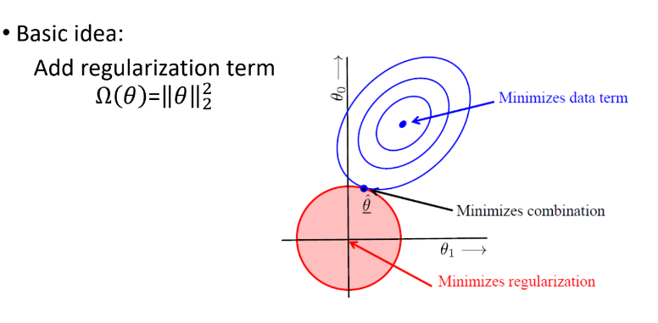
Ridge Regression

Slide 41
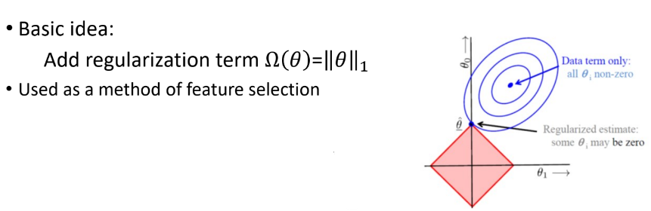
Lasso Regression

Slide 42
L¹ regularization and L² regularization
L¹ regularization, minimizes the sum of the absolute values
L² regularization minimizes the sum of squares.
• Choosing L¹ or L² That depends on the specific problem
L¹ regularization has an important advantage: it tends to produce a
sparse model. That is, it often sets many weights to zero, effectively
declaring the corresponding attributes to be irrelevant.

Slide 43
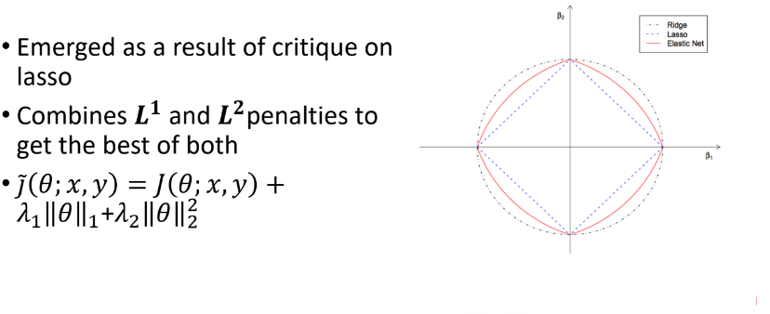
Elastic net

Slide 44
How about if we have multiple inputs?

Slide 45
Assessing the Accuracy of the Model
The quality of a linear regression fit is typically assessed using two related quantities:
Mean square error (MSE)
R² statistic.
They are all based on Sum of squared Errors (SSE) or RSS

Slide 46
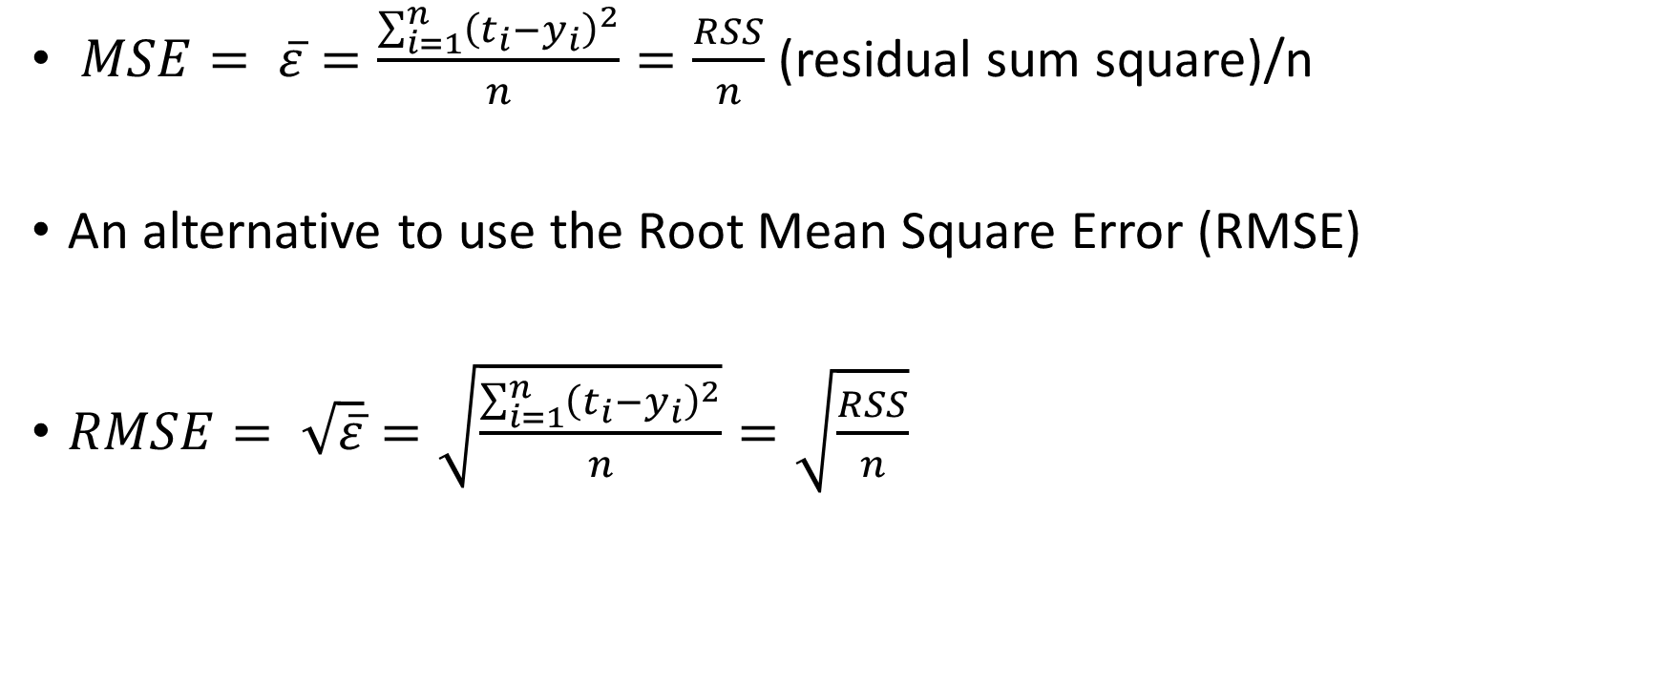
Mean Square Error (MSE)
$MSE= \overline{ε}=\frac{\sum_{i=1}^{n}{{\left(t_{i}−y_{i}\right)}^{2}}}{n}=\frac{RSS}{n}$(residual sum square)/n
An alternative to use the Root Mean Square Error (RMSE)
$RMSE= \sqrt{\overline{ε}}=\sqrt{\frac{\sum_{i=1}^{n}{{\left(t_{i}−y_{i}\right)}^{2}}}{n}}=\sqrt{\frac{RSS}{n}}$

Slide 47
RMSE
RMSE provides a good assessment but it is measured in the units of Y (depends on the scale of y).
Think of a range of y [1- 10] and another scale [1- 10000].
It is not always clear what constitutes a good RMSE.

Slide 48
Feature Selection

Slide 49
Best Subset Selection
We fit a separate least squares regression for each possible combination of the p predictors (Features).
That is, we fit all d models selection that contain exactly one predictor, all models that contain exactly two predictors, and so forth.
We then look at all of the resulting models, with the goal of identifying the one that is best.
Think of p variables. Each variables has a value of true (included in the model) or false (not included). What is the possible number of models
We have 2^{p} models

Slide 50
Sequential Feature Selection
For computational reasons, best subset selection cannot be applied with very large p.
The larger the search space, the higher the chance of finding models that look good on the training data, even though they might not have any predictive power on unseen data.
For these reasons, stepwise methods, which explore a far more restricted set of models, can be used
Two methods
Forward Stepwise Selection
Backward Stepwise Selection

Slide 51
Other Techniques
Removing features with low variance
Zero-variance (constant) features do not explain the variability in the output.
Model-based selection
Use models such as Lasso regression to select features

Slide 52
In machine learning tasks, we need to:
Choose, from a range of different types, the best algorithm for the particular problem at hand
Finding appropriate values for hyper-parameters within a given model.
We cannot use the test data for tuning hyper-parameters. Why?
How can we perform model selection?

Slide 53
Key techniques
Use a validation set
a set of examples that the training algorithm does not observe.
Drawbacks:
Reduces the training set
For small datasets, the validation estimate of the test error rate can be highly variable, depending on precisely which observations are included in the training set and which observations are included in the validation set.
Cross Validation
an alternative procedure that enables us to use all of the examples in the estimation of the mean test error
the price of increased computational cost.
Methods:
Leave-One-Out Cross-Validation
k-Fold Cross-Validation

Slide 54
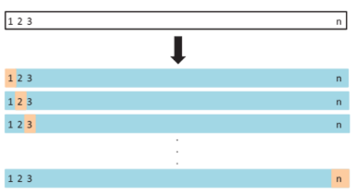
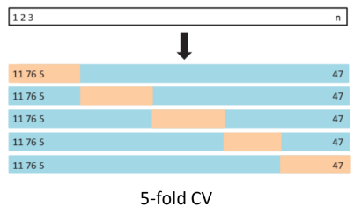
Cross Validation
Leave One out:
K-folds:

